Slide 1




Accelerating Blockchain Networks
IBM Blockchain Platform Explored
Aaron Anderson, Matthew Golby-Kirk
September 14, 2018

Slide 2



Introductions
Moderator:
Aaron Anderson
Apps Services
North America
Speaker:
Matthew Golby-Kirk
Blockchain Engagement Team
North America

Slide 3
Agenda
Topic approx. time
IBM Blockchain Platform Overview 10 min.
Getting Started 15 min.
Technical Deep Dive 45 min.
In this webinar, the learner will gain a more advanced knowledge on blockchain and gain a technical deep-dive into parts of the IBM blockchain platform.
Acknowledgements:
This material was created by IBM.

Slide 4
Chapter 1: IBM Blockchain Platform Overview

Slide 5
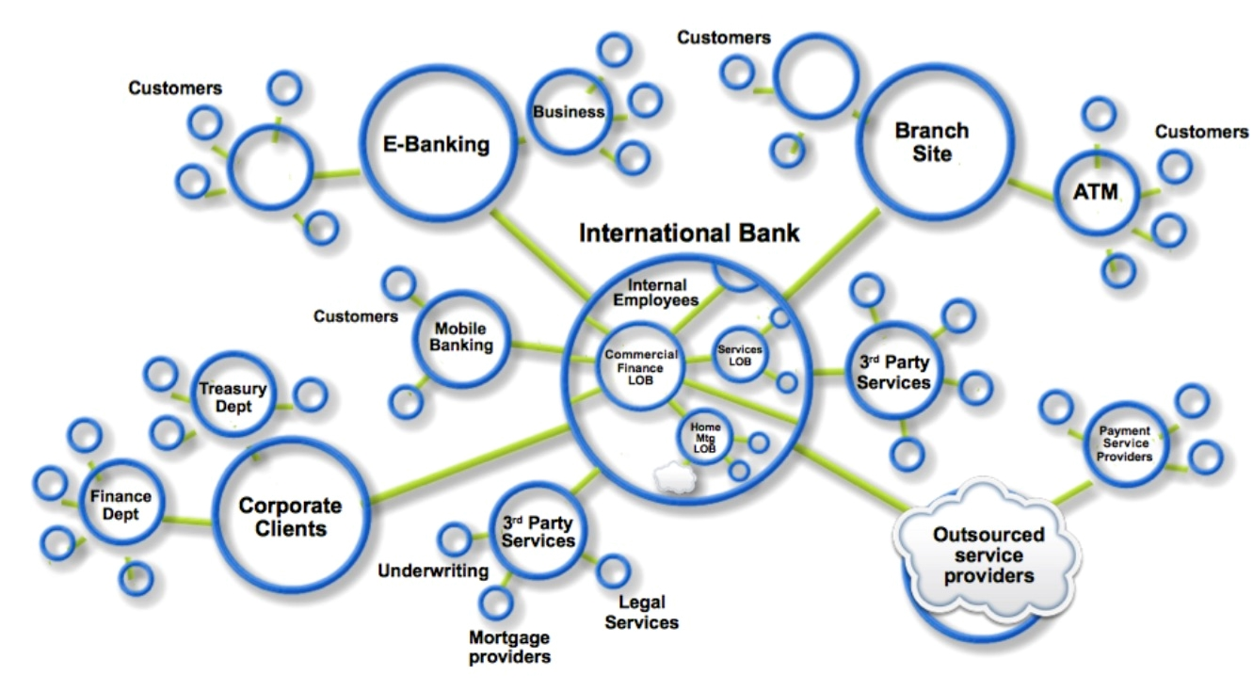
Blockchain Recap
Blockchain builds on basic business concepts
Business Networks connect businesses
Participants with Identity
Assets flow over business networks
Transactions describe asset exchange
Contracts underpin transactions
The ledger is a log of transactions
Blockchain is a shared, replicated permissioned ledger
Consensus, provenance, immutability, finality

Slide 6
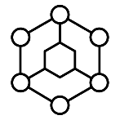



IBM Blockchain Strategy
Drive the development of applications for specific business use-cases, to be deployed to active blockchain networks
Tap into our diverse ecosystem to develop strategic partnerships and create your competitive advantage
Ecosystem
Services
Solve critical industry challenges by building and joining new business networks and applications
Solutions
Collaborate with services teams from ideation all the way to production
Develop, govern and operate enterprise blockchain networks with speed and security
Platform
A founding, premier member of Hyperledger, IBM is committed to open source, standards & governance

Slide 7
Survey
Survey
Have you had any experience with Hyperledger Fabric or Composer?
Yes, lots
A little
No, it’s all new to me
Survey

Slide 8
Introducing the IBM Blockchain Platform
IBM Blockchain Platform is a fully integrated enterprise-ready blockchain platform designed to accelerate the development, governance, and operation of a multi-institution business network
Developer tools that make use of Hyperledger Composer to quickly build your blockchain application
Hyperledger Fabric provides the ledger, which is managed through a set of intuitive operational tools
Governance tools for democratic management of the business network
Flexible deployment options, including a highly secure and performant IBM Cloud environment
Blockchain application
Hyperledger Composer
Developer Tools
Operational Tools
Governance Tools
Hyperledger Fabric
IBM Cloud
http://ibm.biz/Platform_Demo

Slide 9



End-to-end lifecycle coverage
Develop | Govern | Operate
Accelerated creation of blockchain applications No-charge development and test tools hosted on IBM Cloud Based on popular Hyperledger Composer toolset | Activate, customize and change complete blockchain business networks Secure democratic governance across organizations Implement rules for authorizing network updates | Connect, deploy and manage blockchain peers with flexible deployment options Production ready, secure and scalable Based on Linux Foundation Hyperledger Fabric V1

Slide 10
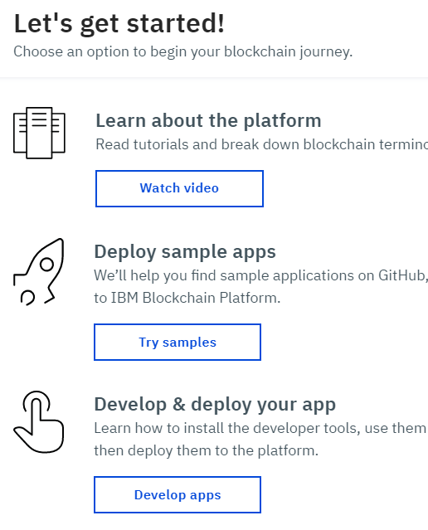
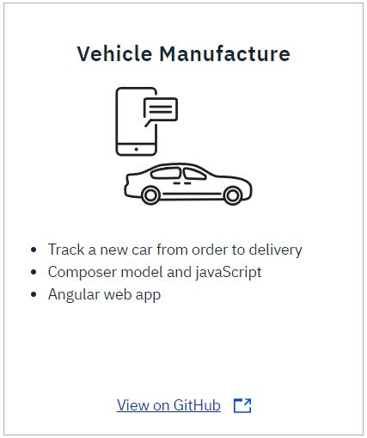
Starter Plan
Get started with IBM Blockchain Platform with one-click setup and a fully functional network
One-click network configuration, code samples and support for Hyperledger Fabric 1.1
Environment enables iterative development prior to production deployment
Same experience as Enterprise
Uses SOLO ordering for simplified configuration, development and testing
Monthly of charge of $500 for two peers
$250 membership fee per month, plus $125 per peer
Receive $500 in IBM Cloud credits on sign-up
Make sure you delete all services after use to avoid being billed
Sign up at www.ibm.com/blockchain
Notes:
Delete the services for what the bill is

Slide 11
IBM Blockchain Platform Membership Plans | Starter | Enterprise | Enterprise Plus
Suitability
MVP | ✔ | ✔ | ✔
Pilot & PoC | ✔ | ✔ | ✔
Pre-production & Staging | ✔ | ✔ | ✔
Production |  | ✔ | ✔
Features
Deploy and run Composer apps | ✔ | ✔ | ✔
Hyperledger Fabric features and capabilities | ✔ | ✔ | ✔
Multiple org simulation | ✔ | ✔ | ✔
Rolling migrations with no network outages | ✔ | ✔ | ✔
Low-code interface | ✔ | ✔ | ✔
Ability to scale | ✔ | ✔ | ✔
Support options | ✔ | ✔ | ✔
Fault tolerant ordering service |  | ✔ | ✔
Cryptographic Acceleration |  | ✔ | ✔
HSM Available |  | ✔ | ✔
Advanced Secure container technology |  | ✔ | ✔
Isolated Compute Environment |  |  | ✔
Multi-Geo/Site DR |  |  | ✔

Slide 12
Chapter 2: Getting Started
The Tools to Make Your Blockchain Real

Slide 13



?
Your
idea
The Business
Network

Slide 14
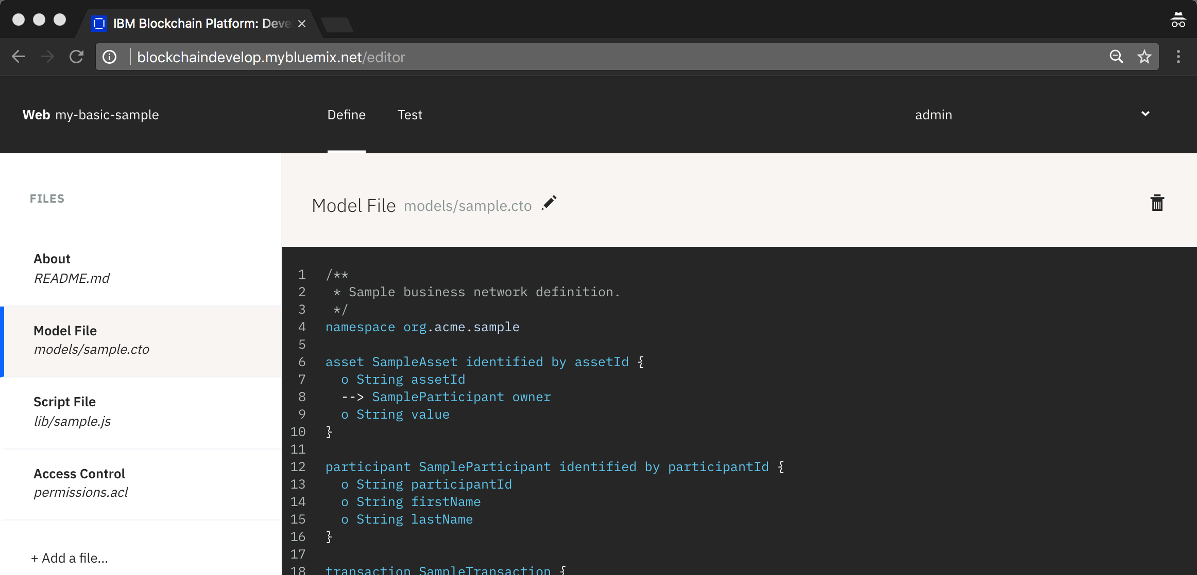
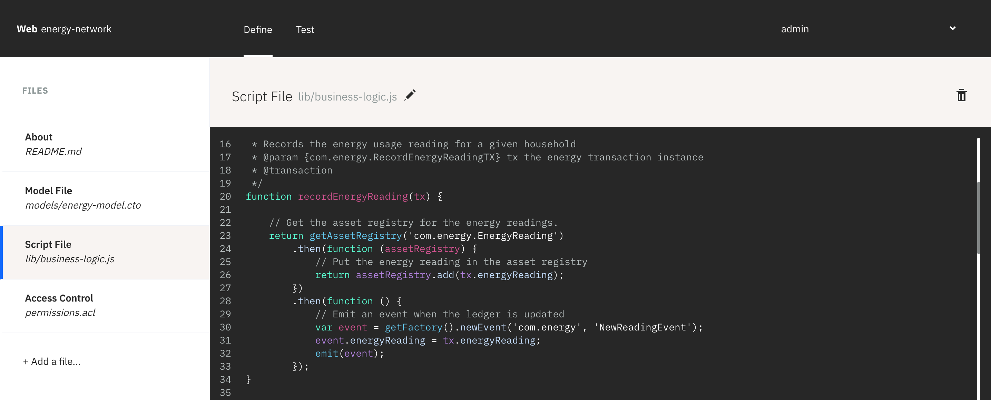

Model, Build
and Code
Your
idea
The Business
Network
Build

Slide 15
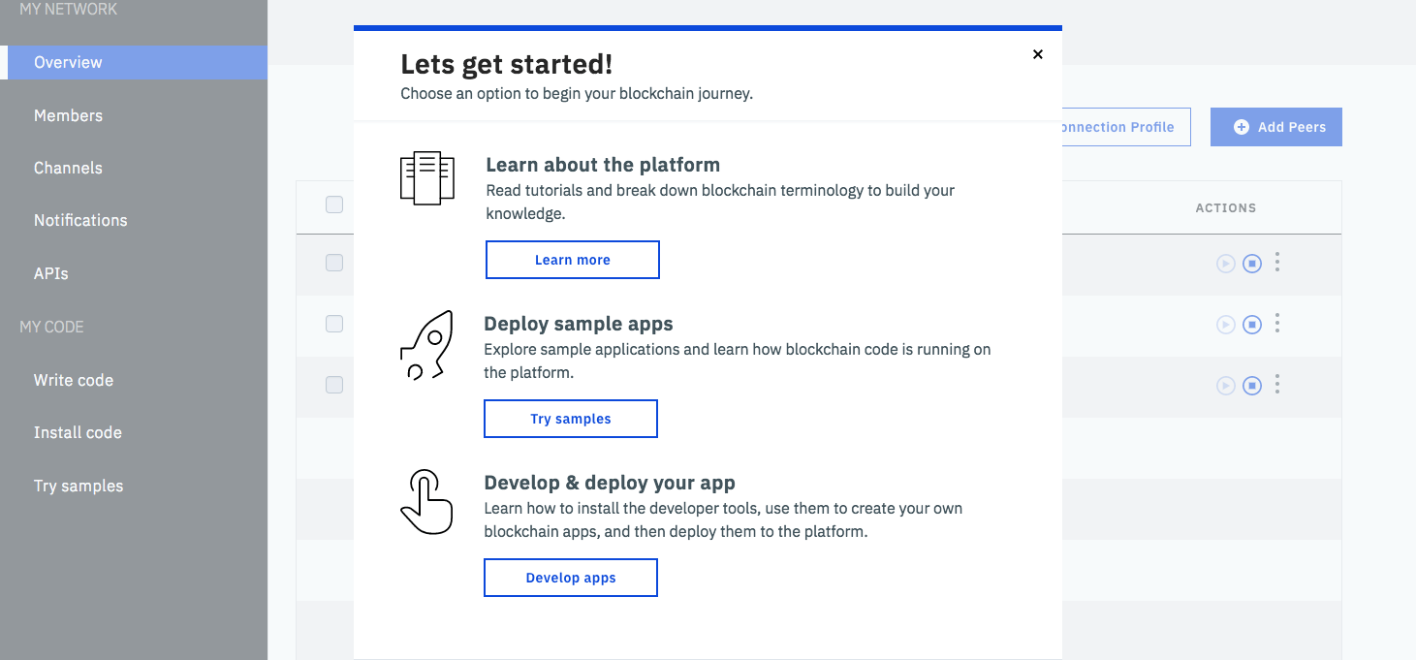

Get started
with tips
Your
idea
The Business
Network
Build

Slide 16
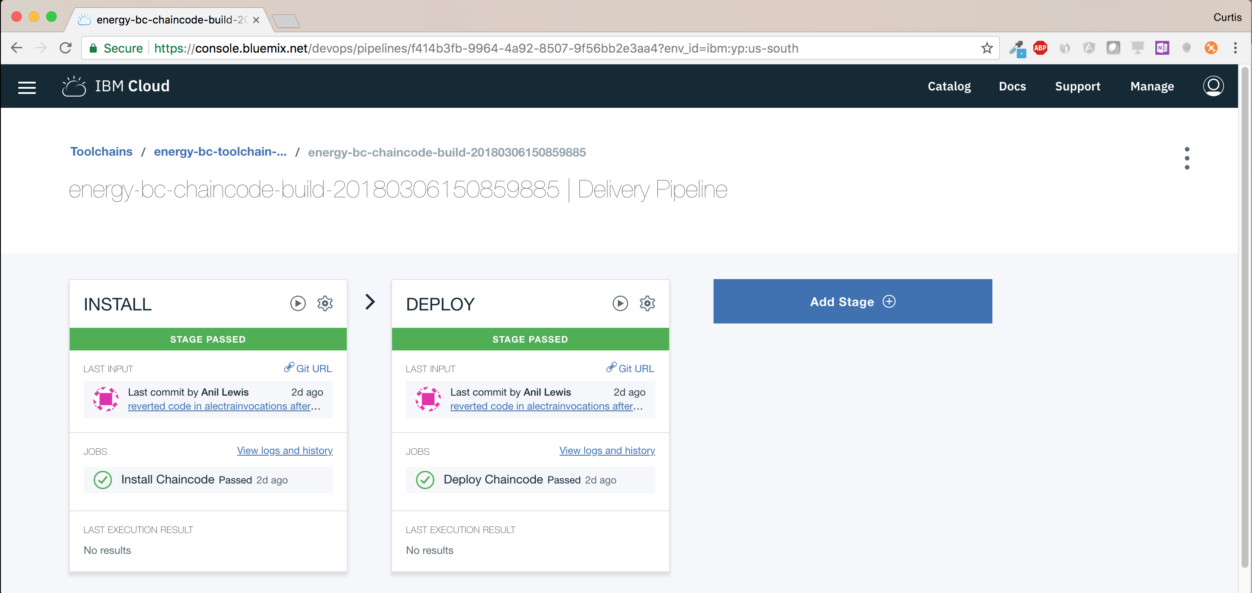

Automated
DevOps
Your
idea
The Business
Network
Build

Slide 17
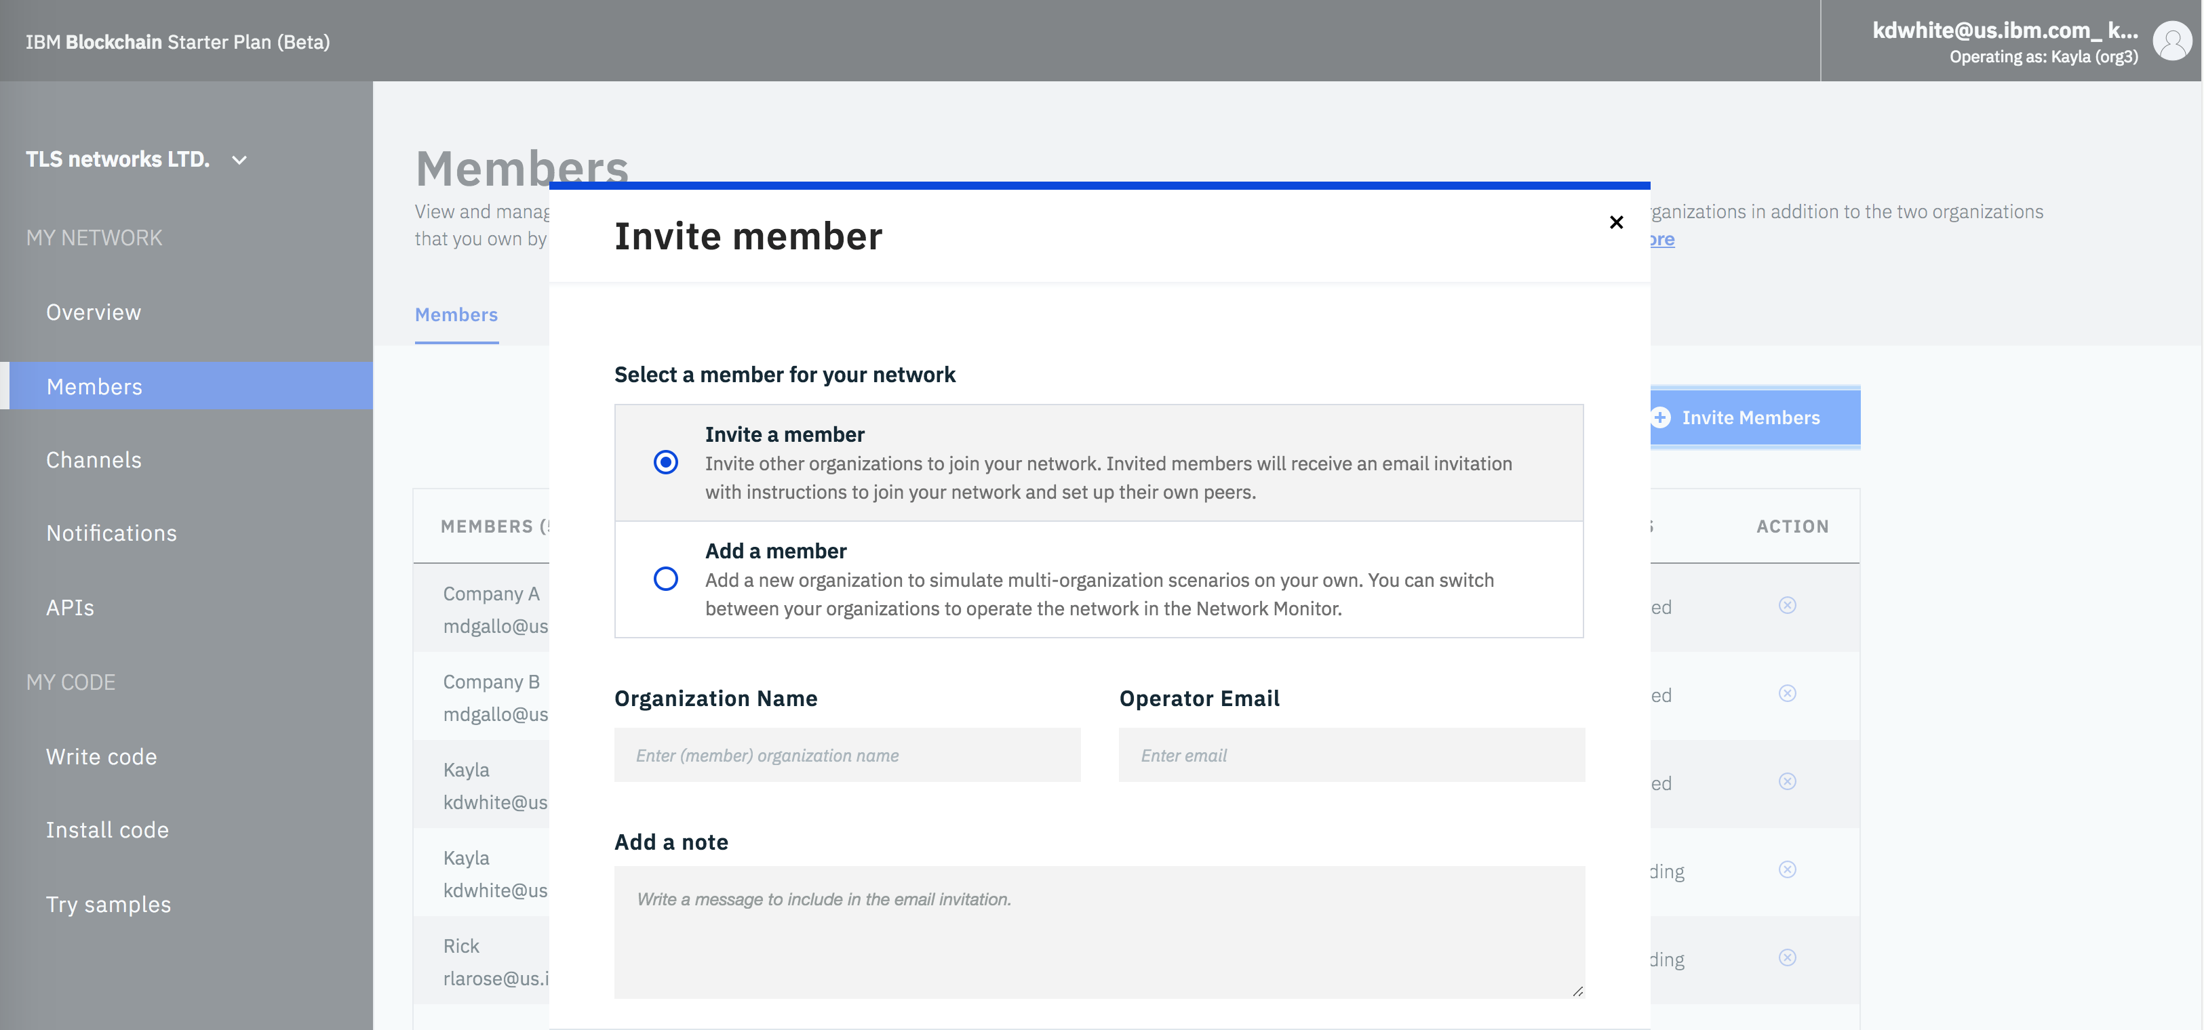
Add new members
Your
idea
The Business
Network
Build
Grow

Slide 18
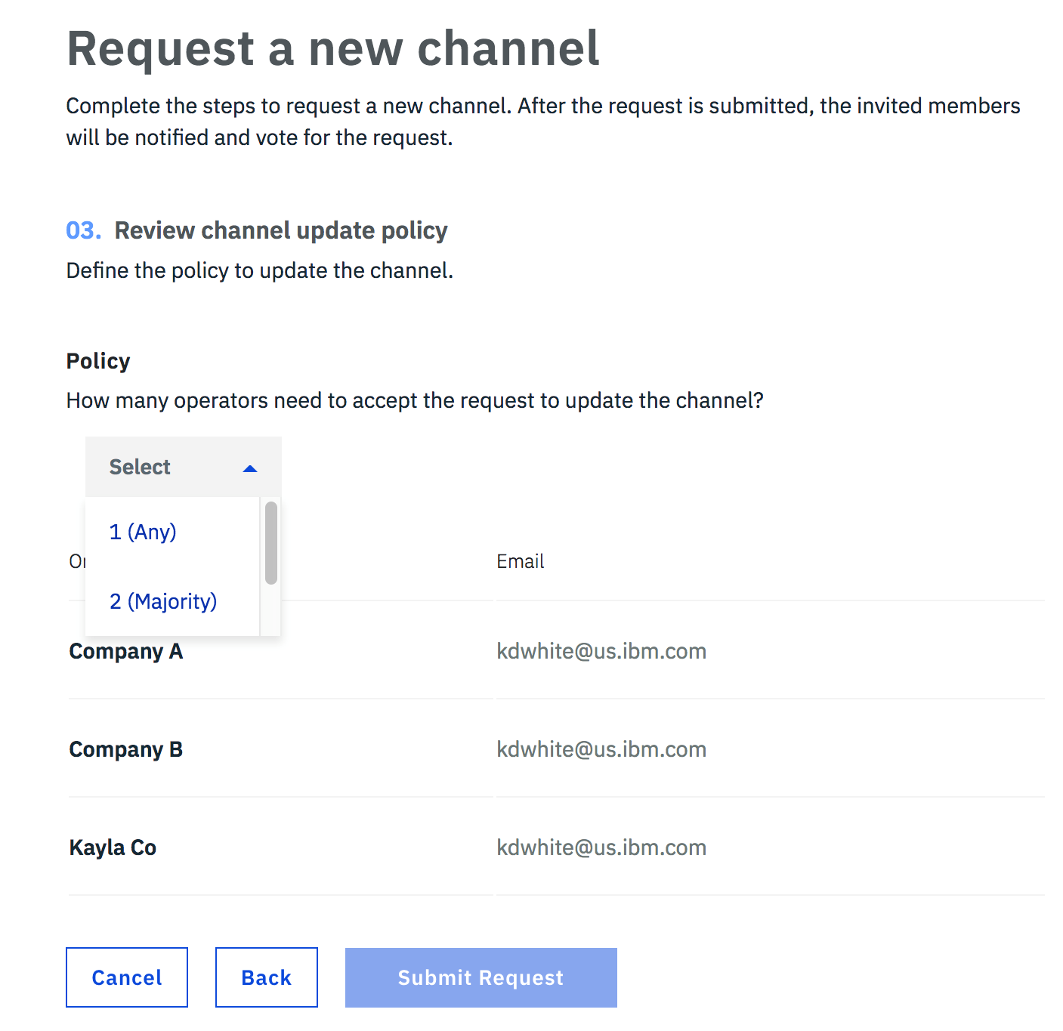
Set policies
Your
idea
The Business
Network
Build
Grow

Slide 19
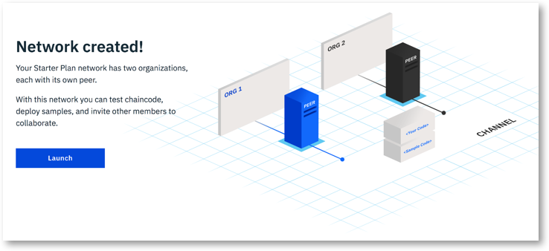
Your
idea
The Business
Network
Build
Grow

Slide 20




Blockchain Technical Concepts
🔑
🔑
Peers are the networked services that maintain ledger state and run smart contracts
Channels are defined subsets of the peer network that share a single ledger
Certificate authorities provide identity services to participants on the network
✓
✓
✓
Smart contracts constitute the transaction logic whose output is agreed by the peer network
Consensus is the process by which agreement is obtained on the peer network
The Ordering Service agrees transaction sequence and distributes blocks to peers

Slide 21
Chapter 3: Technical Deep Dive

Slide 22


IBM Blockchain Platform Components
External-CA
Fabric-CA
Admin
CA
optional
Membership
Services
optional
CA
Peer
Endorser
Application
SDK
Committer
O
Ledger
Users
Chaincode
A
B
O
O
Events
!
Hardware Security Module
Ordering-Service

Slide 23
How applications interact with the ledger
Accesses
Blockchain
Developer
Develops
Application
SDK
Submits
Chaincode
Emits
!
Get, Put, Delete
Record
0
1
2
3
Emits
!
Blockchain
WorldState
Ledger
Peer

Slide 24
Chapter 3: Technical Deep Dive Architectural Overview

Slide 25


Network Architecture and Participant Roles
Network Service Provider
Network Service Consumer
Business Service Provider
Business Service Consumer
End-User
governs
operates
develops
hosts
runs
Hyperledger Composer
IBM Blockchain Platform
Hyperledger Fabric
Smart Contracts
App server and Integration logic
App
Business APIs
Application APIs
Secure Cloud
Ordering Service
Peer network & Certificate Authorities
Data Layer
| Business Application Layer |
Presentation Layer

Slide 26
Workflow for Network Formation
Network Service Provider
Create network
Invite members
Policy Lifecycle
Network Service Consumer
Accept invite
Create channels
Deploy smart contracts (1)
Peer and certificate management
Business Service Provider
Updates to application logic
Develop and deliver blockchain application logic: smart contracts (1), business (2), presentation (3)
Business Service Consumer
Deploy business logic (2)
Manage end-user identity
Create app server / integration infrastructure
Download presentation logic (3)
Run presentation logic
End-User
Time

Slide 27


















How the architecture fits with enterprise services & processes
Governance
Monitoring & Logging
Continuous integration
Continuous delivery
Business Monitoring
Security Monitoring
Composer
IBM Blockchain Platform
Fabric
Smart Contracts
API Management
Microservices
App
BPM
Gateway
Application Logic
Ordering Service
Events
Secure Cloud
Transformation & Connectivity
Edge Services
Device
IoT
Existing Systems of Record
Enterprise User Directory
Cloud Data Source
Content Management
Enterprise Data
Enterprise App
AI
Data Layer
| Business Application Layer |
Presentation Layer

Slide 28

Organisations
Each member organisation defines boundaries within the network
An organisation is created within the scope of an IBM Cloud Account
An IBM Cloud Account can create multiple organisations on its behalf
Each organisation includes:
Membership Services Provider (MSP) for identities
Administrator(s)
Users
Peers
Fabric-CAs
A network includes many organisations representing a consortium
Each organisation has an ID
User
Admin
E
CA
E
CA
MSP
Peer
ID = Org1
IBM Cloud Account

Slide 29
Initial Starter Plan Network
The initial setup for a starter plan network which is intended for development purposes
CA
E
Plan | Starter
Ordering Service | Solo (1 orderer)
Initial # of orgs | 3
Max # of orgs | Unlimited*
Initial peers per org | 1
Max peers per org | Unlimited
CPU per peer | 1
RAM per peer | 2GB
CA nodes per org | 1
Max Storage | 20GB (network)
Max # of channels | 150
Max # of instantiations | 10
A
B
Org1
O
CA
E
A
B
Org2
OrdererOrg
Initiator
IBM
Network
(*) Additional orgs and peers within initiator’s cloud membership

Slide 30
Fabric Ledger
The Fabric ledger is maintained by each peer and includes the blockchain and worldstate
A separate ledger is maintained for each channel the peer joins
Transaction read/write sets are written to the blockchain
Channel configurations are also written to the blockchain
The worldstate can be either LevelDB (default) or CouchDB
LevelDB is a simple key/value store
CouchDB is a document store that allows complex queries
The smart contact decides what is written to the worldstate
Config Block
0
Config
Block
1
Transaction
Block
2
Transaction
Block
3
Worldstate
Genesis
Blockchain

Slide 31
Summary of a Block
This is a summary of a block within the ledger
Header |  |  | Number | Previous hash (merkel root) |  | Data hash (merkel root)
Block Data (repeated per transaction) | Signature |  | Client signature of transaction payload
 | Payload | Header | Channel Header (timestamp, tx_id, type, …) |  | Signature Header (client certificate) | Signature Header (creator certificate)
 |  | Data | Client certificate |  | MspId
 |  |  | Proposal payload |  | Proposal hash
 |  |  | Array of keys read (key and version of value)
 |  |  | Array of keys written (key/value and delete flag)
 |  |  | Array of range_queries (start/end key and list)
 |  |  | Events (chaincode_id, tx_id, name, payload)
 |  |  | Chaincode response (status, message, payload)
 |  |  | Chaincode ID (path, name, version)
 |  |  | Array of endorsers (mspid, certificate, signature)
Block Metadata |  |  | Array of orderers (mspid, certificate, signature)
 |  |  | Array of transaction valid flags
Block
Index
Data

Slide 32
Chapter 3: Technical Deep Dive Network Consensus

Slide 33
Nodes and roles
 | Peer: Maintains ledger and state. Commits transactions. May hold smart contract (chaincode).
 | Endorsing Peer: Specialized peer also endorses transactions by receiving a transaction proposal and responds by granting or denying endorsement. Must hold smart contract.
 | Ordering Node: Approves the inclusion of transaction blocks into the ledger and communicates with committing and endorsing peer nodes. Does not hold smart contract. Does not hold ledger.

Slide 34
Hyperledger Fabric Consensus
Endorse
Order
Validate
Consensus is achieved using the following transaction flow:

Slide 35
Sample transaction: Step 1/7 – Propose transaction
Application proposes transaction
Endorsement policy:
“E_{0,} E₁ and E₂ must sign”
(P₃, P₄ are not part of the policy)
Client application submits a transaction proposal for Smart Contract A. It must target the required peers {E₀, E₁, E₂}
Org1
E₀
P₃
P₄
A
B
A
D
E₁
Org2
Application
SDK
O
OrdererOrg
A
B
E₂
Org3
O
O
Key:
A
Endorser |  |  | Ledger
Peer |  |  | Application
Ordering Node
Smart Contract (Chaincode) |  |  | Endorsement Policy
B
Network
P

Slide 36

Sample transaction: Step 2/7 – Execute proposal
Endorsers Execute Proposals
E₀, E₁ & E₂ will each execute the proposed transaction. None of these executions will update the ledger
Each execution will capture the set of Read and Written data, called RW sets, which will now flow in the fabric.
Transactions can be signed & encrypted
Org1
E₀
P₃
P₄
A
B
A
D
E₁
Org2
Application
SDK
O
OrdererOrg
A
B
E₂
Org3
O
O
Key:
A
Endorser |  |  | Ledger
Peer |  |  | Application
Ordering Node
Smart Contract (Chaincode) |  |  | Endorsement Policy
B
Network
P

Slide 37
Sample transaction: Step 3/7 – Proposal Response
Application receives responses
RW sets are asynchronously returned to application
The RW sets are signed by each endorser, and also includes each record version number
(This information will be checked much later in the consensus process)
Org1
E₀
P₃
P₄
A
B
A
D
E₁
Org2
Application
SDK
O
OrdererOrg
A
B
E₂
Org3
O
O
Key:
A
Endorser |  |  | Ledger
Peer |  |  | Application
Ordering Node
Smart Contract (Chaincode) |  |  | Endorsement Policy
B
Network
P

Slide 38
Sample transaction: Step 4/7 – Order Transaction
Responses submitted for ordering
Application submits responses as a transaction to be ordered.
Ordering happens across the fabric in parallel with transactions submitted by other applications
Org1
E₀
P₃
P₄
A
B
A
D
E₁
Org2
Application
SDK
O
OrdererOrg
A
B
Org3
O
O
E₂
Key:
Endorser |  |  | Ledger
Peer |  |  | Application
Ordering Node
Smart Contract (Chaincode) |  |  | Endorsement Policy
A
B
Network
P
(other applications)

Slide 39
Sample transaction: Step 5/7 – Deliver Transaction
Orderer delivers to committing peers
Ordering service collects transactions into proposed blocks for distribution to committing peers. Peers can deliver to other peers in a hierarchy (not shown)
Different ordering algorithms available:
SOLO (Single node, development)
Kafka (Crash fault tolerance)
Org1
E₀
P₃
P₄
A
B
A
D
*
E₁
Org2
Application
SDK
O
OrdererOrg
A
B
E₂
Org3
O
O
Key:
A
Endorser |  |  | Ledger
Peer |  |  | Application
Ordering Node
Smart Contract (Chaincode) |  |  | Endorsement Policy
B
Network
P

Slide 40

Sample transaction: Step 6/7 – Validate Transaction
Committing peers validate transactions
Every committing peer validates against the endorsement policy. Also check RW sets are still valid for current world state
Validated transactions are applied to the world state and retained on the ledger
Invalid transactions are also retained on the ledger but do not update world state
Org1
E₀
P₃
P₄
*
A
B
*
A
D
*
E₁
Org2
Application
SDK
O
OrdererOrg
A
B
*
E₂
Org3
O
O
Key:
A
Endorser |  |  | Ledger
Peer |  |  | Application
Ordering Node
Smart Contract (Chaincode) |  |  | Endorsement Policy
*
B
Network
P

Slide 41
Sample transaction: Step 7/7 – Notify Transaction
Committing peers notify applications
Applications can register to be notified when transactions succeed or fail, and when blocks are added to the ledger
Applications will be notified by each peer to which they are connected
Org1
E₀
P₃
P₄
!
!
!
A
B
A
D
E₁
Org2
Application
SDK
!
!
O
OrdererOrg
A
B
E₂
Org3
O
O
!
Key:
A
Endorser |  |  | Ledger
Peer |  |  | Application
Ordering Node
Smart Contract (Chaincode) |  |  | Endorsement Policy
B
Network
P

Slide 42
Chapter 3: Technical Deep Dive Channels

Slide 43
Channels
Channels provide privacy between different ledgers
Ledgers exist in the scope of a channel
Channels can be shared across an entire network of peers
Channels can be permissioned for a specific set of participants
Chaincode is installed on peers to access the worldstate
Chaincode is instantiated on specific channels
Peers can join multiple channels
Concurrent execution for performance and scalability
E₀
O
O
O
E₁
Ordering-Service

Slide 44
Single Channel Enterprise Network
All peers connect to the same system channel (blue).
All peers have the same chaincode and maintain the same ledger
Endorsement by peers E_{0,} E_{1,} E₂ and E₃
SDK
CA
E₀
E₂
CA
SDK
Application
O
Application
A
A
B
B
O
O
CA
E₁
E₃
CA
A
P
A
B
B
Org1
OrdererOrg
Org1
Initiator
IBM
Member
Network

Slide 45
Multi Channel Enterprise Network
Peers E₀ and E₃ connect to the red channel for chaincodes Y and Z
E_{1,} E₂ and E₃ connect to the blue channel for chaincodes A and B
SDK
CA
E₀
E₂
CA
SDK
Application
O
Application
Y
A
Z
B
O
O
CA
E₁
E₃
CA
A
P
P
Y
B
Z
Org1
OrdererOrg
Org1
Initiator
IBM
Member
Network

Slide 46
Chapter 3: Technical Deep Dive Network Setup

Slide 47
Network Creation (1/8) - Ordering Service Provisioned
A fully managed Crash Fault Tolerant Ordering Service is provisioned by IBM on behalf of the network
O
O
O
CA
OrdererOrg
IBM
Network

Slide 48
Network Creation (2/8) – Org1 Creates The Network
Org1 initiates the creation of the new network
Policies for governance are defined.
Org2 is invited to join the new network
CA
O
O
O
CA
E₁
CA
Org1
OrdererOrg
Initiator
IBM
Network

Slide 49
Network Creation (3/8) – Org2 Joins The Network
Org2 accepts the invitation and joins the new network
CA
CA
O
O
O
CA
E₁
E₂
CA
CA
Org1
OrdererOrg
Org2
Member
IBM
Member
Network

Slide 50
Network Creation (4/8) – Additional Peers Created
If required, admins for each org can add additional peers
2 peers per org are recommended for high-availability
CA
E₀
E₃
CA
O
O
O
CA
E₁
E₂
CA
CA
Org1
OrdererOrg
Org2
Member
IBM
Member
Network

Slide 51
Network Creation (5/8) – Install Chaincode
Admins for each org install chaincode to peers in their org
CA
E₀
E₃
CA
O
Y
A
Z
B
O
O
CA
E₁
E₂
CA
CA
Y
A
Z
B
Org1
OrdererOrg
Org2
Member
IBM
Member
Network

Slide 52
Network Creation (6/8) – Create Channels
Channels are created by an admin in either org. A policy defines which orgs can join the channel
Other orgs receive notification of new channels and can accept or reject.
CA
E₀
E₃
CA
O
Y
A
Z
B
O
O
CA
E₁
E₂
CA
CA
Y
A
P
P
Z
B
Org1
OrdererOrg
Org2
Member
IBM
Member
Network

Slide 53
Network Creation (7/8) – Peers Join Channels
The admin in Org1 joins Peer E₀ to the red channel and E₁ to the blue channel
The admin in Org2 joins Peer E₂ to the red channel and E₃ to the blue channel
CA
E₀
E₃
CA
O
Y
A
Z
B
O
O
CA
E₁
E₂
CA
CA
Y
A
P
P
Z
B
Org1
OrdererOrg
Org2
Member
IBM
Member
Network

Slide 54
Network Creation (8/8) – Instantiate Chaincode
Chaincode is instantiated by an admin in either org
The policy defined in the channel identifies which admins are permissioned
CA
E₀
E₃
CA
O
Y
A
Z
B
O
O
CA
E₁
E₂
CA
CA
Y
A
P
P
Z
B
Org1
OrdererOrg
Org2
Member
IBM
Member
Network

Slide 55
Chapter 3: Technical Deep Dive Endorsement Policies

Slide 56
Endorsement Policies
An endorsement policy describes the conditions by which a transaction can be endorsed. A transaction can only be considered valid if it has been endorsed according to its policy.
Each chaincode is deployed with an Endorsement Policy
ESCC (Endorsement System ChainCode) signs the proposal response on the endorsing peer
VSCC (Validation System ChainCode) validates the endorsements
Endorsing Peer
Committing Peer
Chaincode
ESCC
VSCC
Ledger
Sign
Order - Deliver
Policy
Propose - Execute - Respond
P
Validate - Commit

Slide 57
Endorsement Policy Examples
Examples of policies:
Request 1 signature from all three principals
AND('Org1.member', 'Org2.member', 'Org3.member')
Request 1 signature from either one of the two principals
OR('Org1.member', 'Org2.member')
Request either one signature from a member of the Org1 MSP or (1 signature from a member of the Org2 MSP and 1 signature from a member of the Org3 MSP)
OR('Org1.member', AND('Org2.member', 'Org3.member'))

Slide 58
Chapter 3: Technical Deep Dive Starter Plan Walkthrough

Slide 59
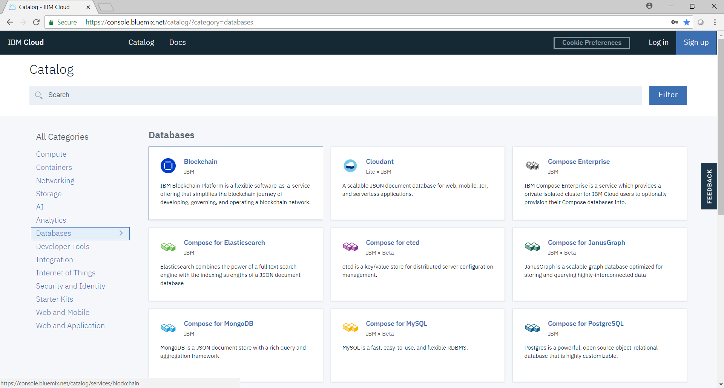

Slide 60
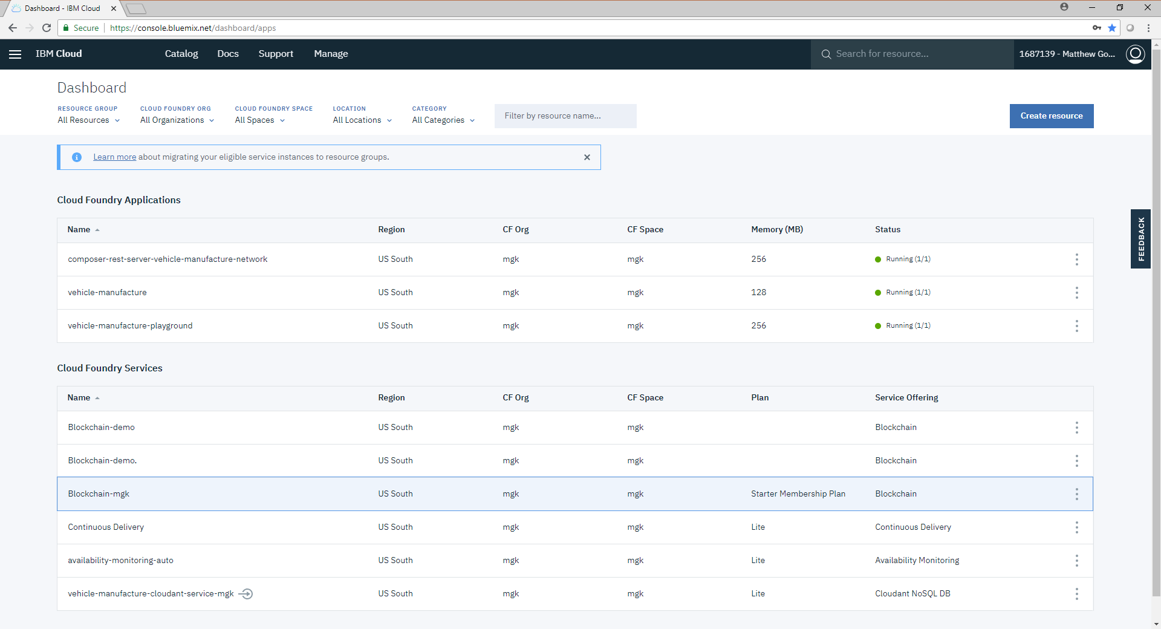

Slide 61
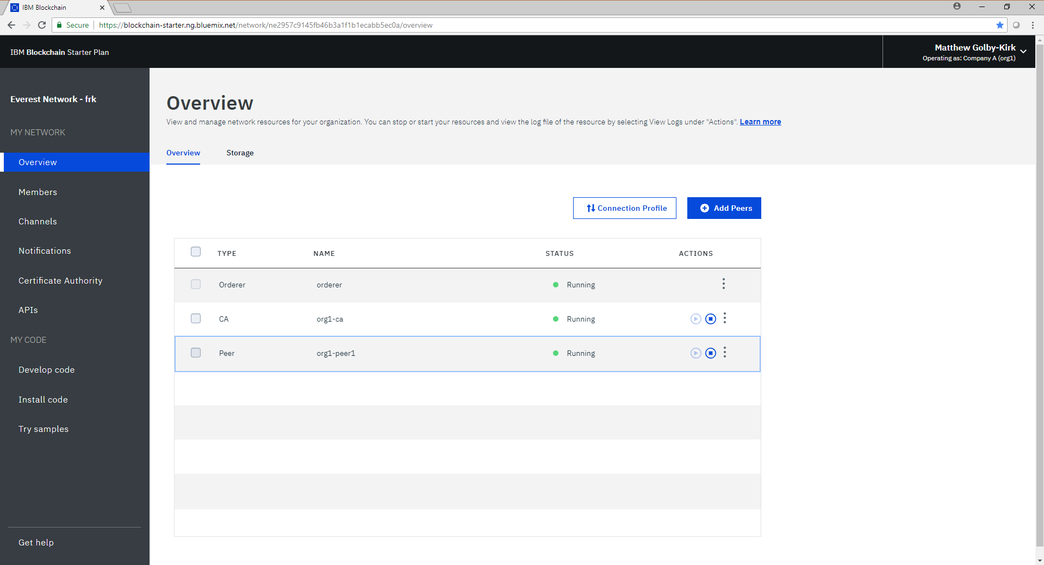

Slide 62
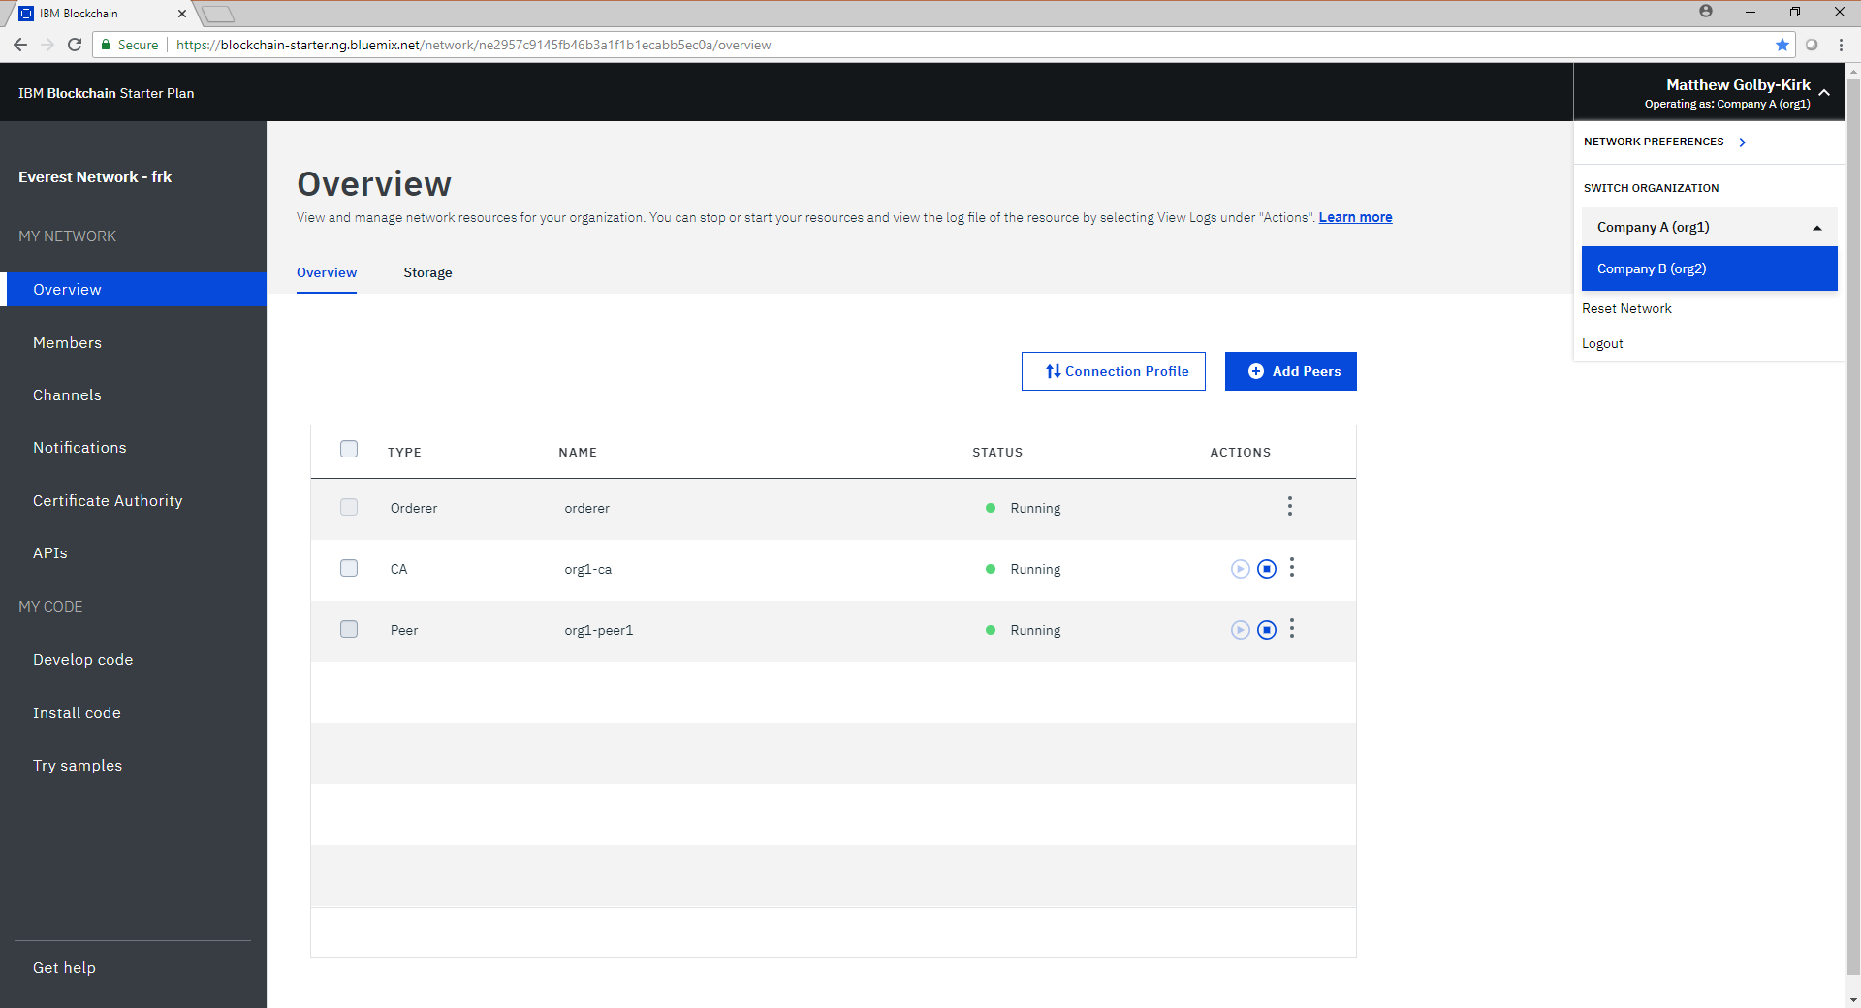

Slide 63
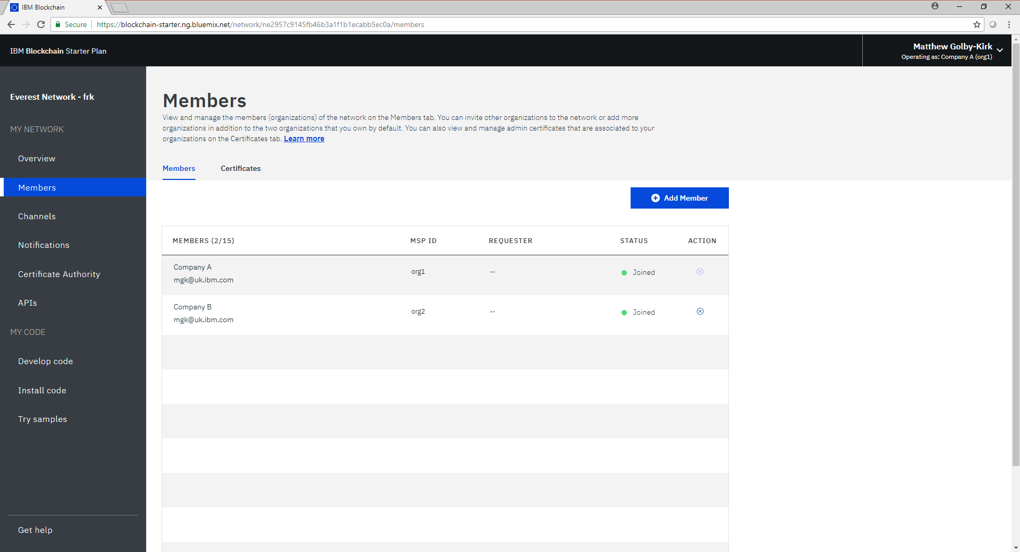

Slide 64
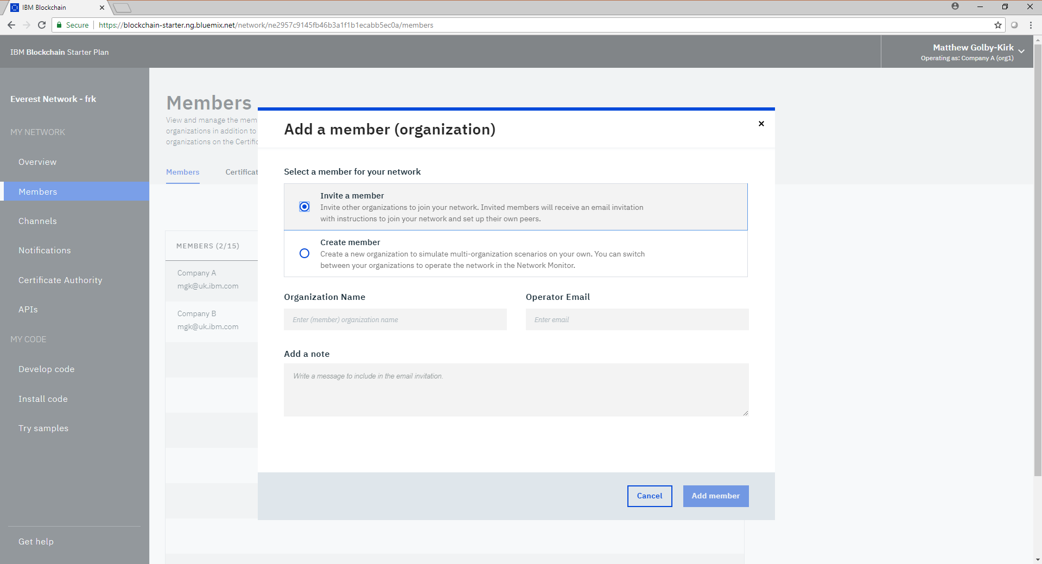

Slide 65
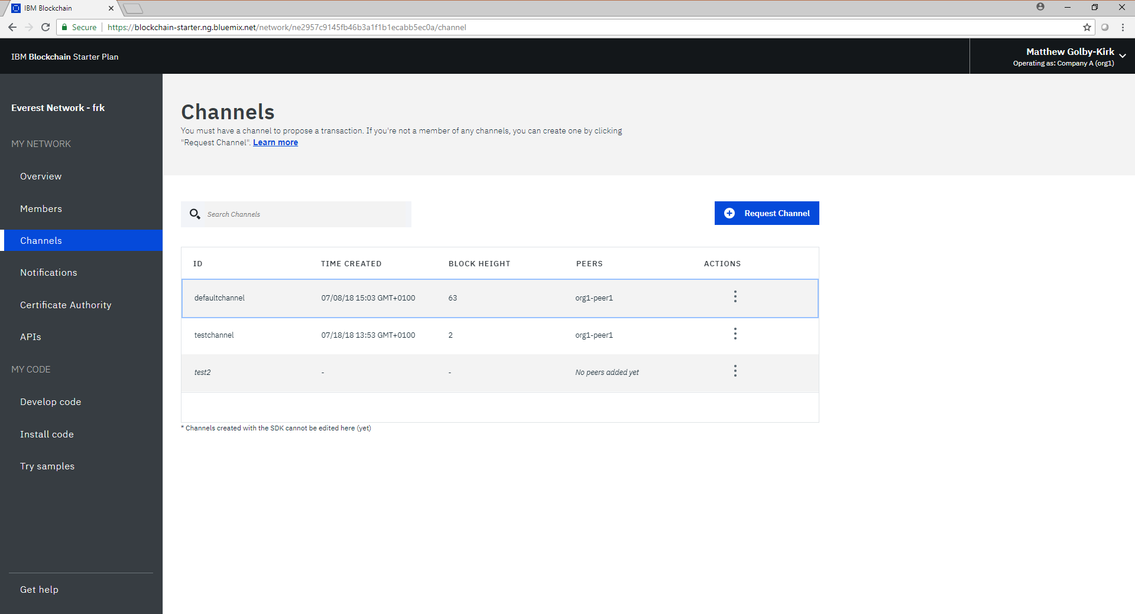

Slide 66
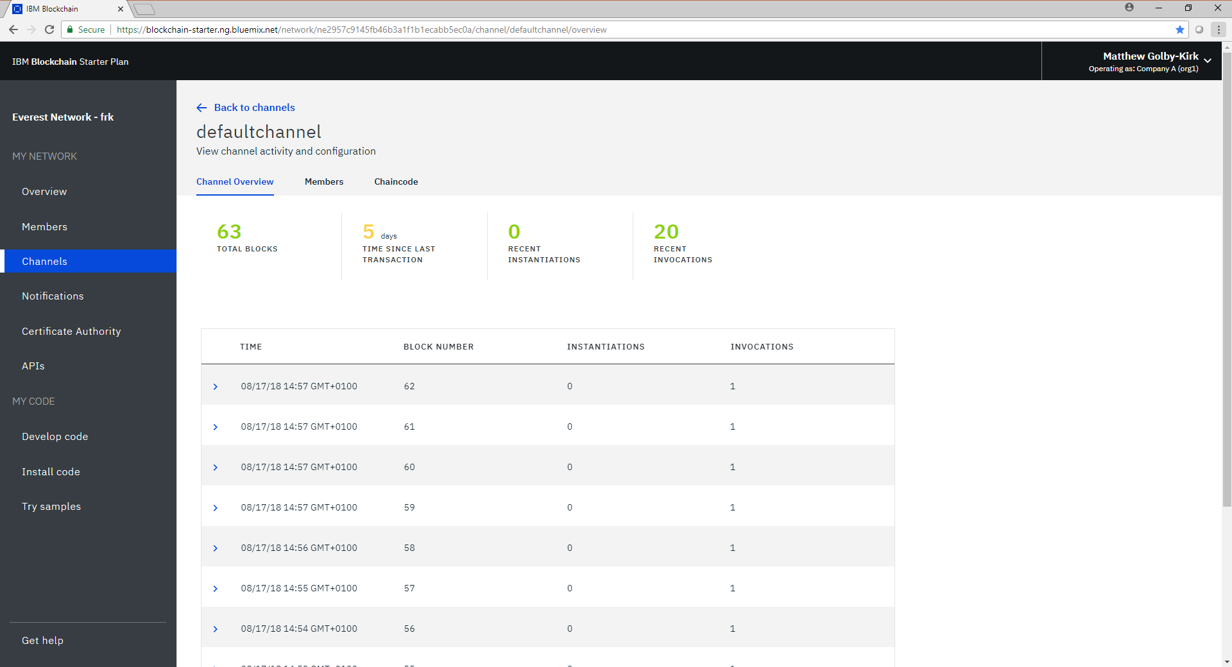

Slide 67
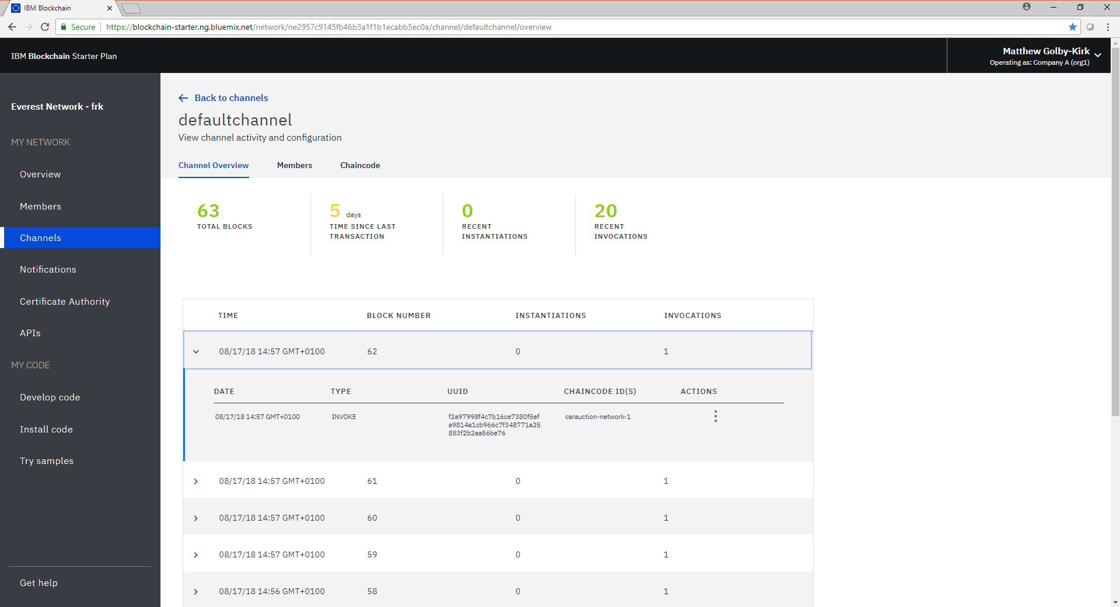

Slide 68
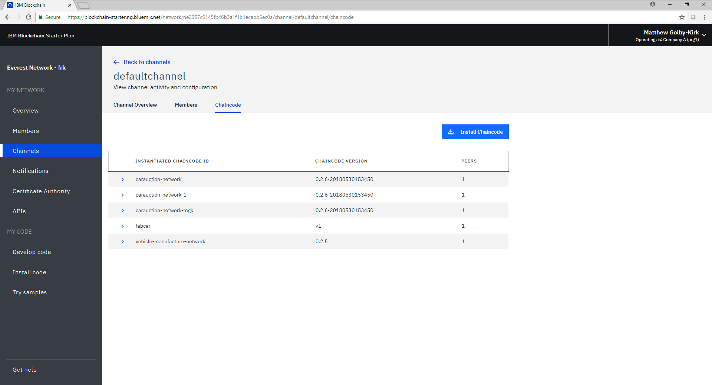

Slide 69
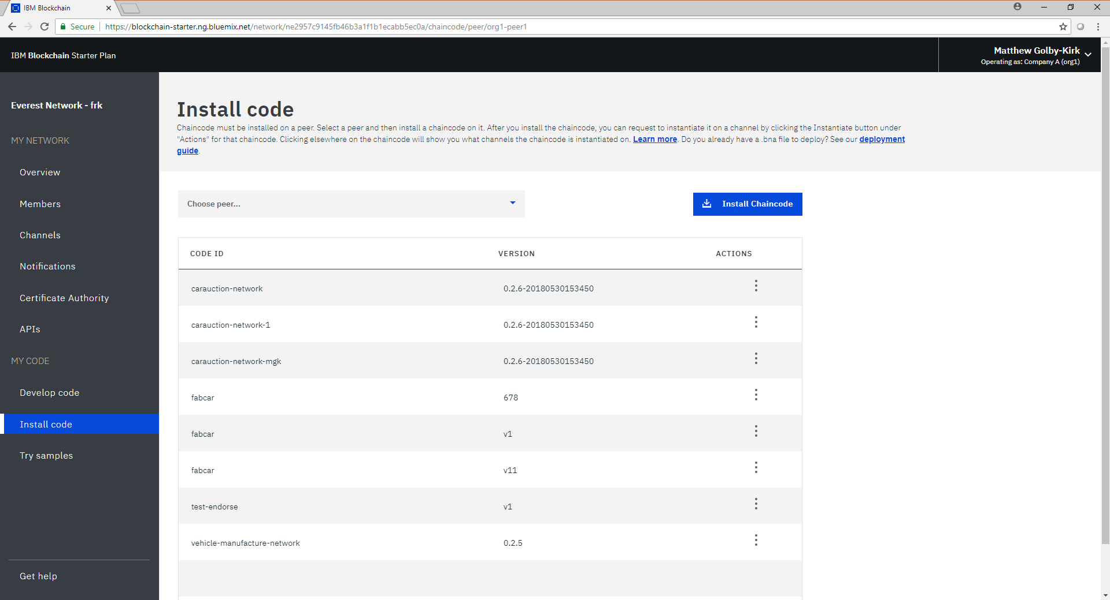

Slide 70
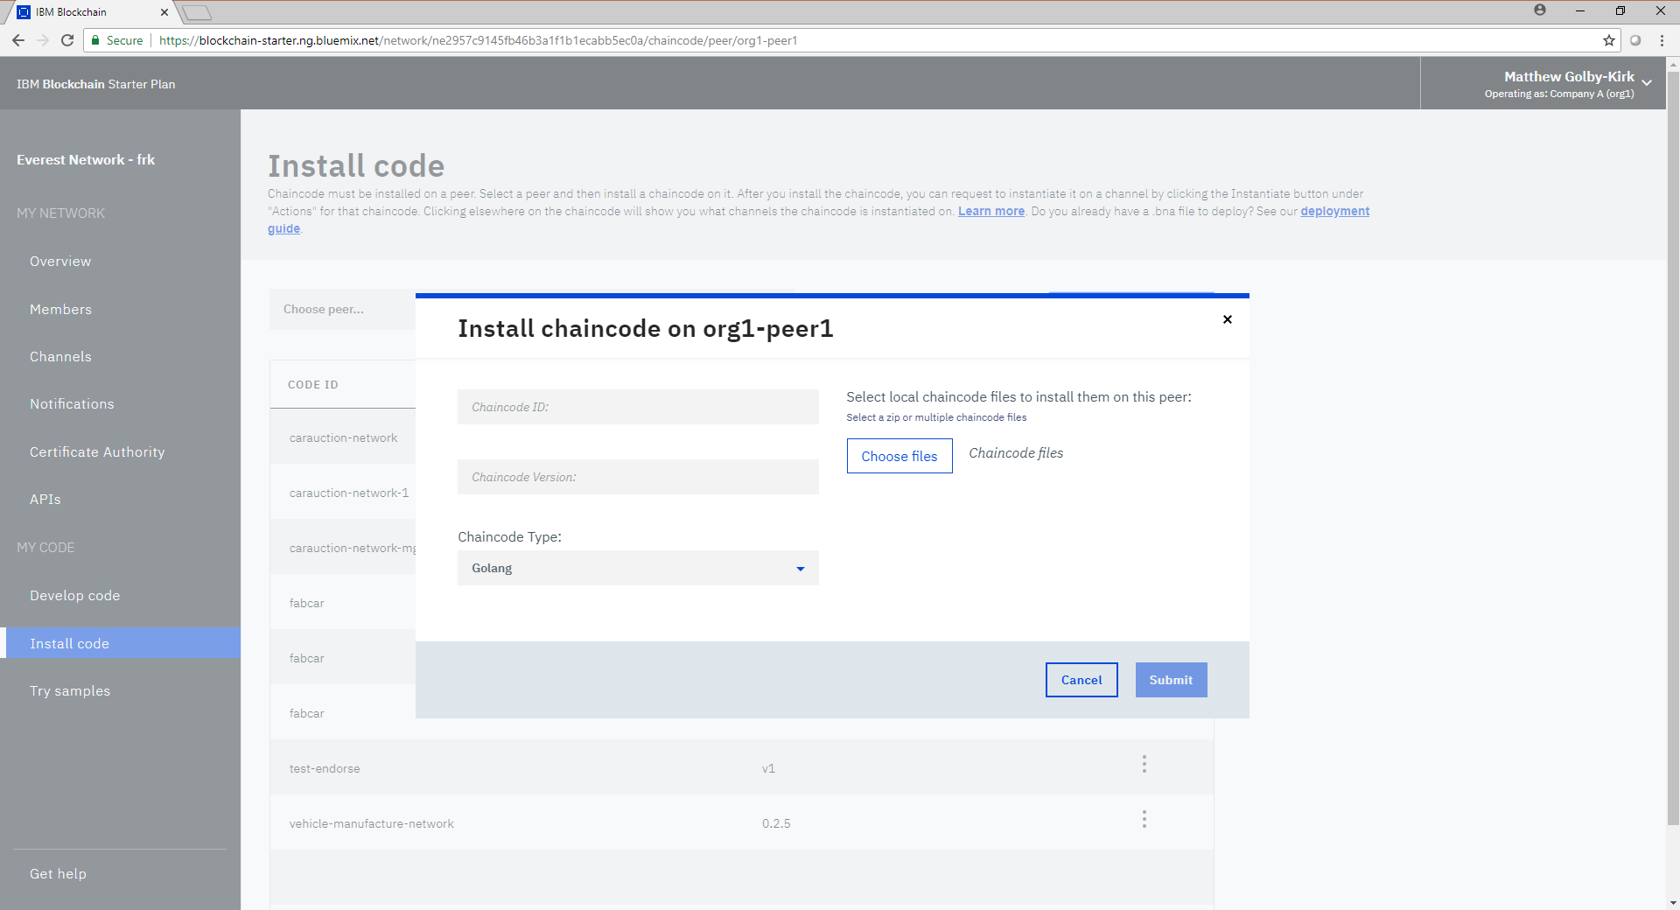

Slide 71
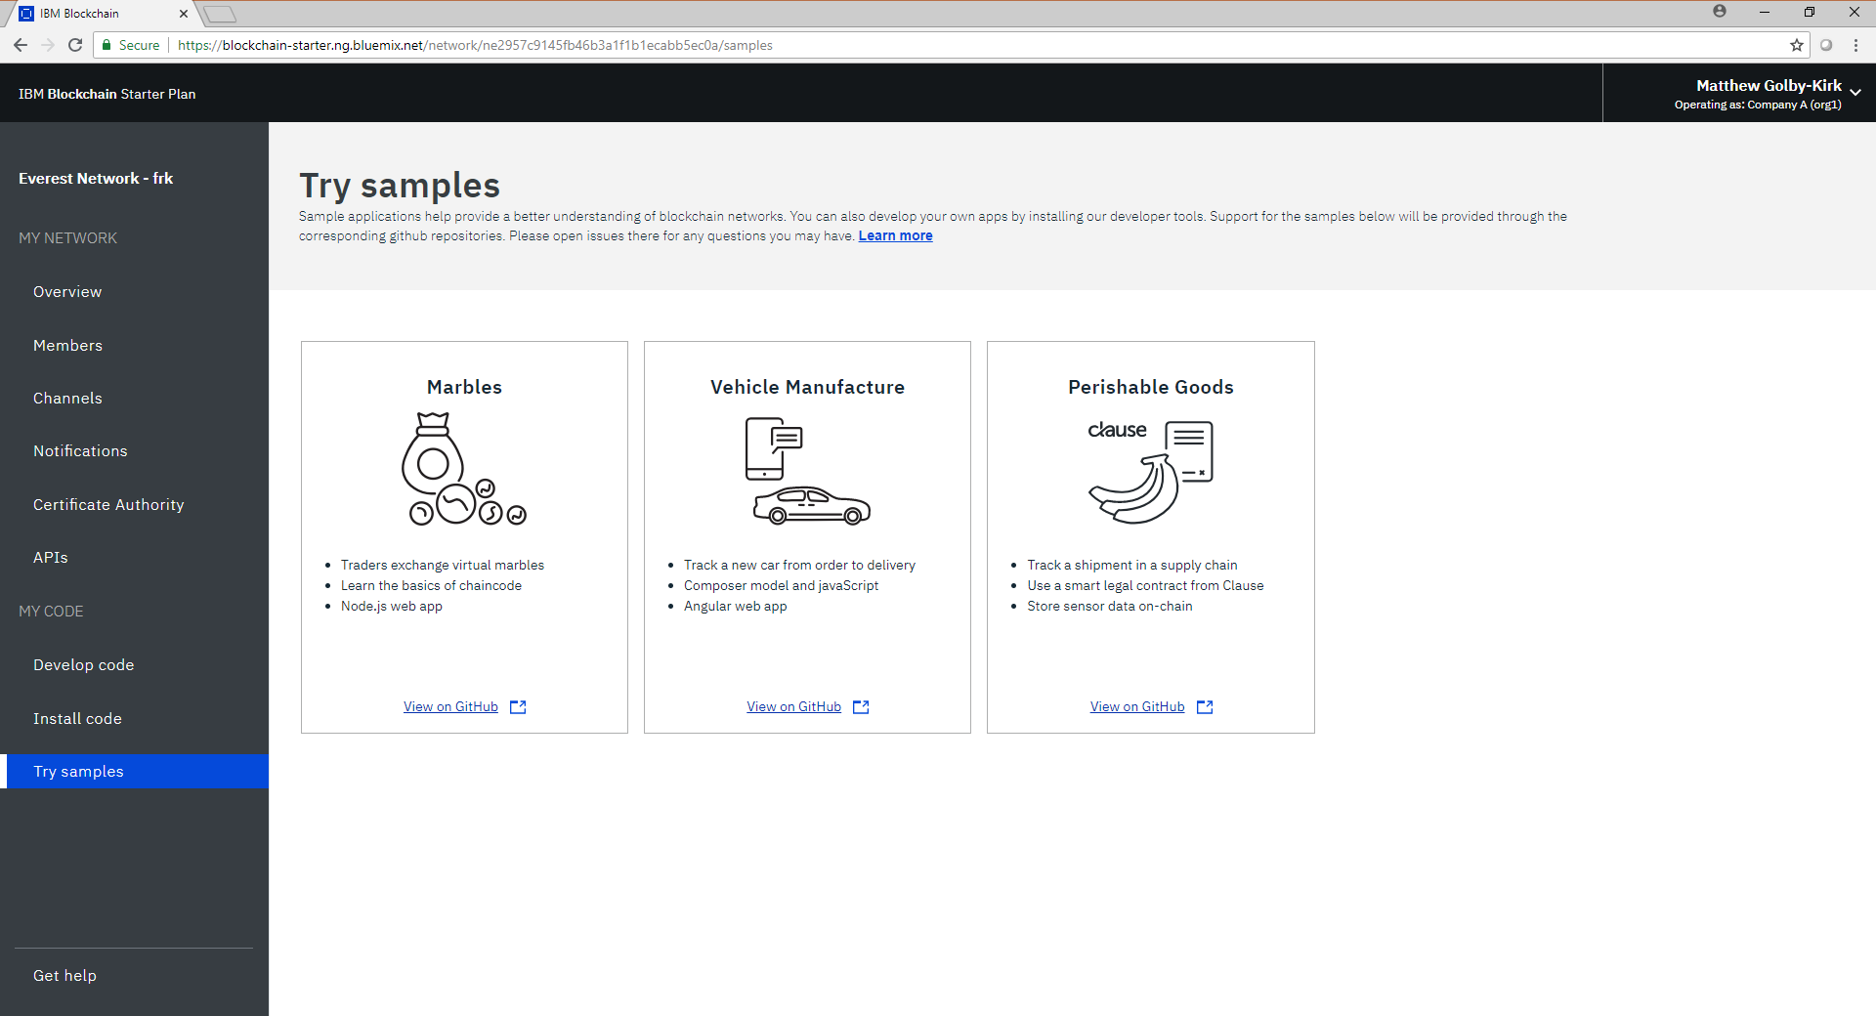

Slide 72
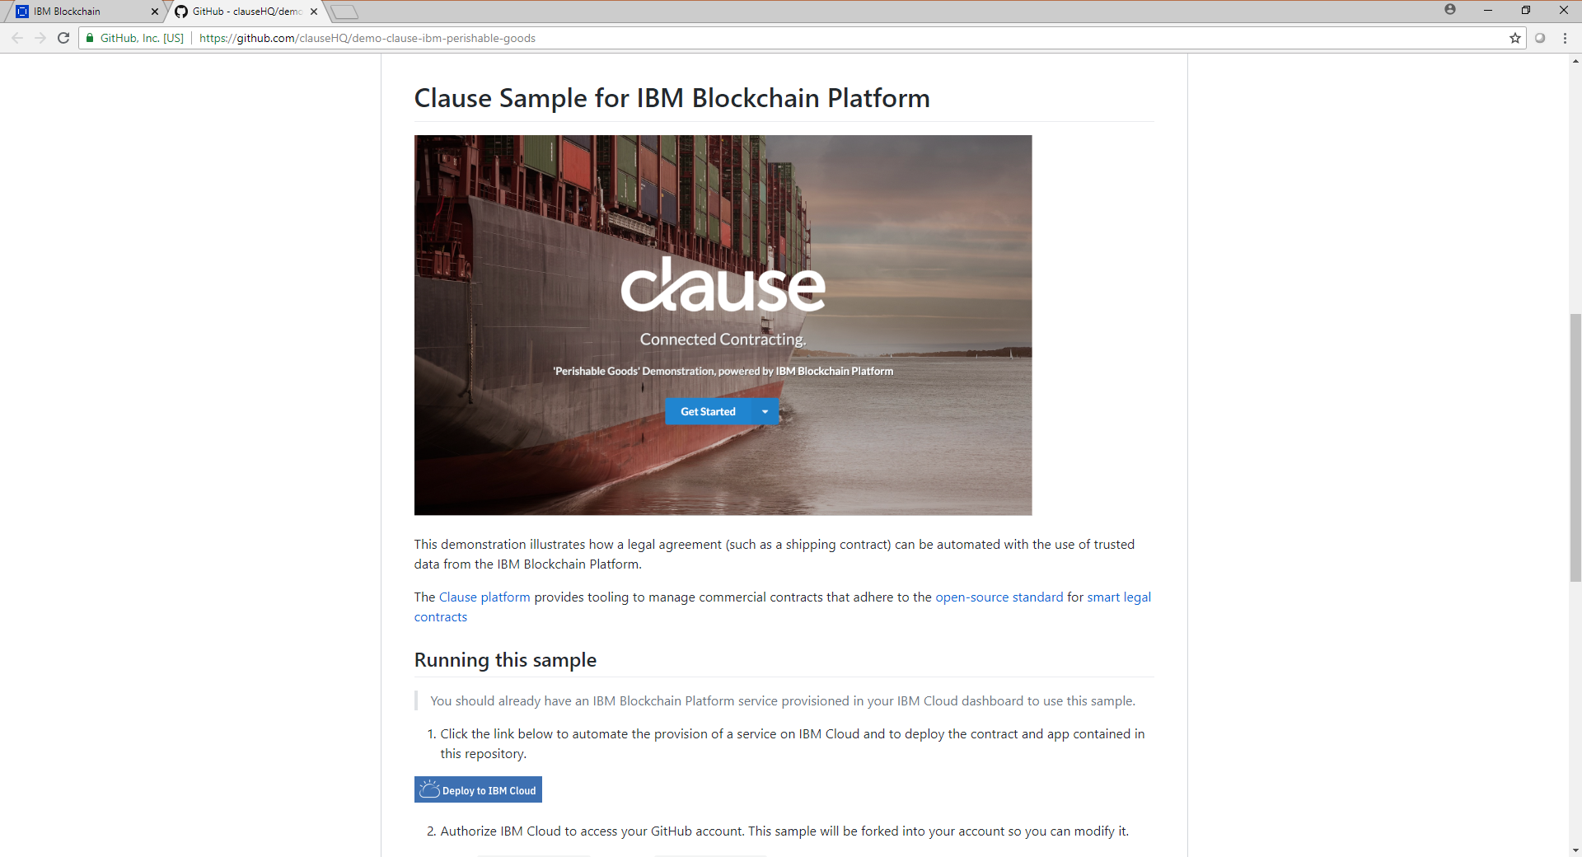

Slide 73
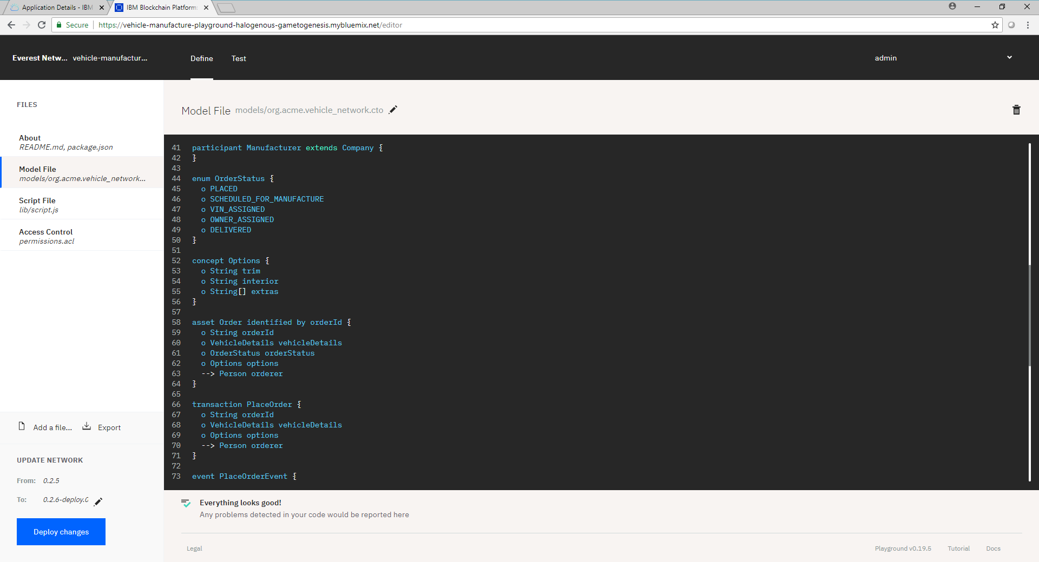

Slide 74
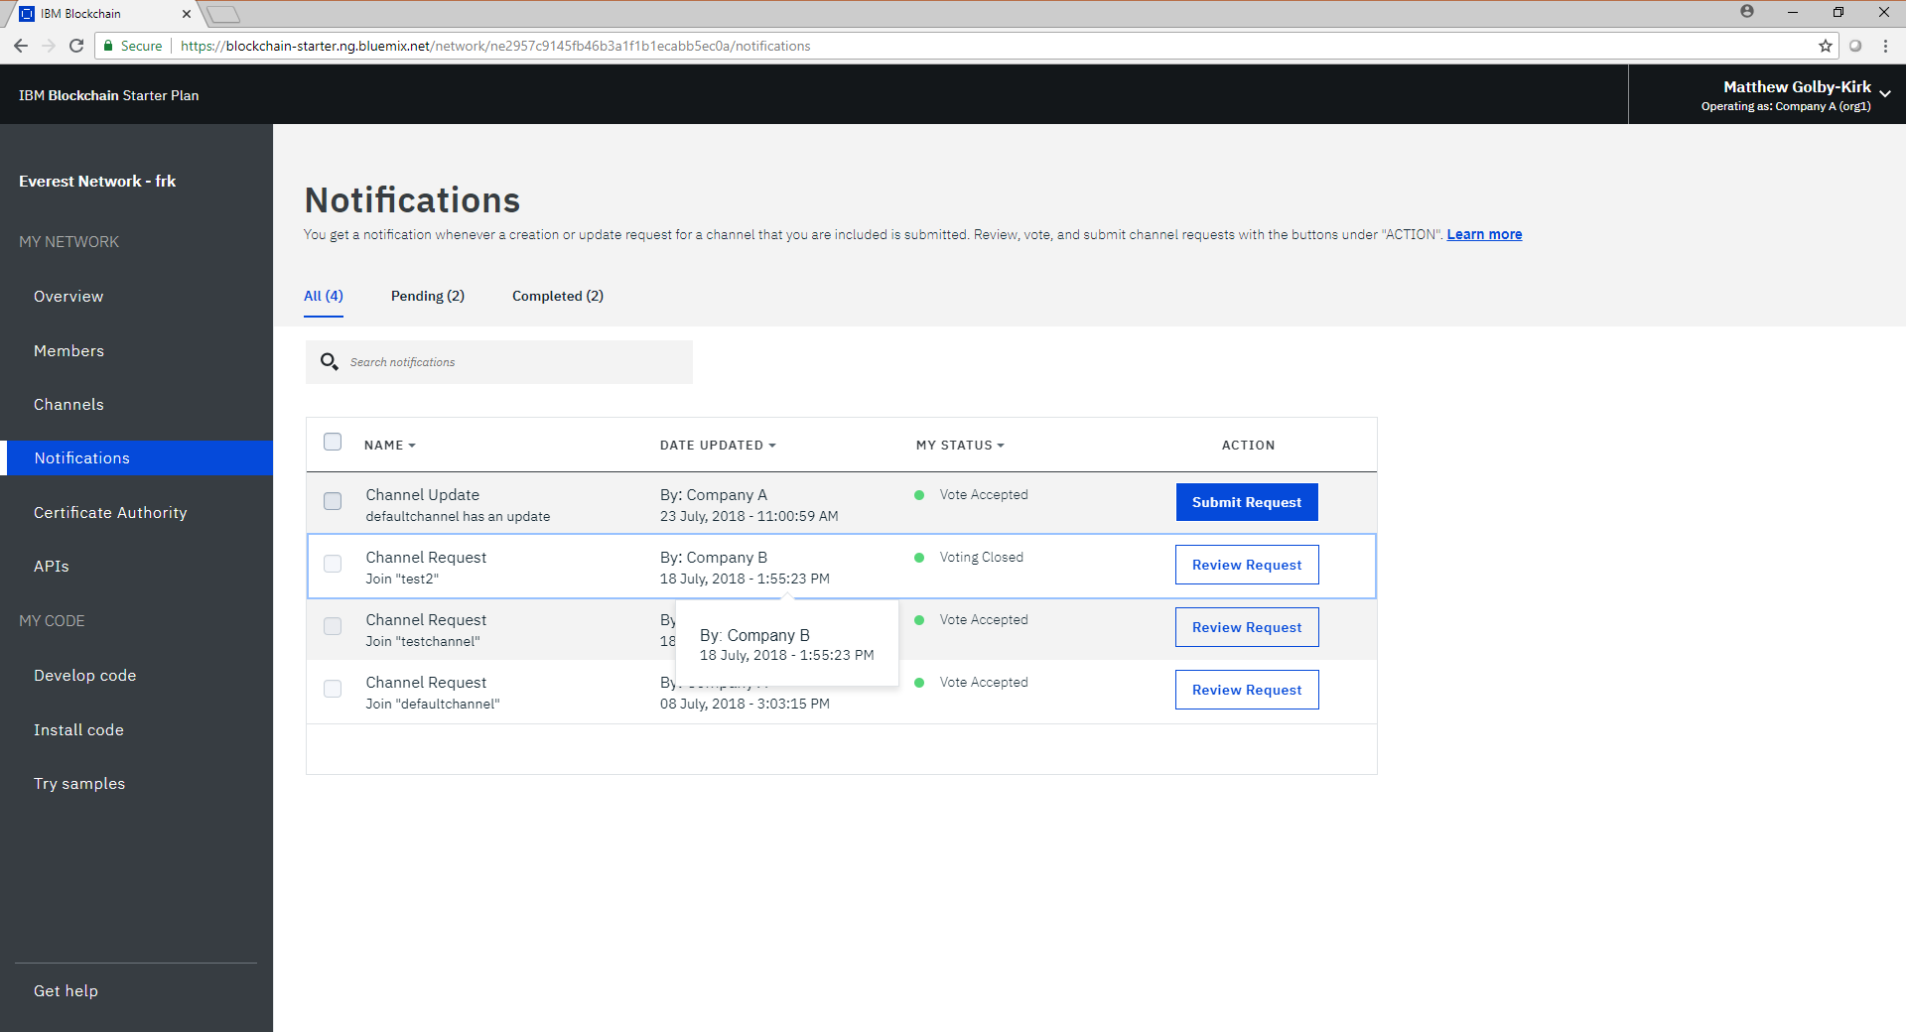

Slide 75
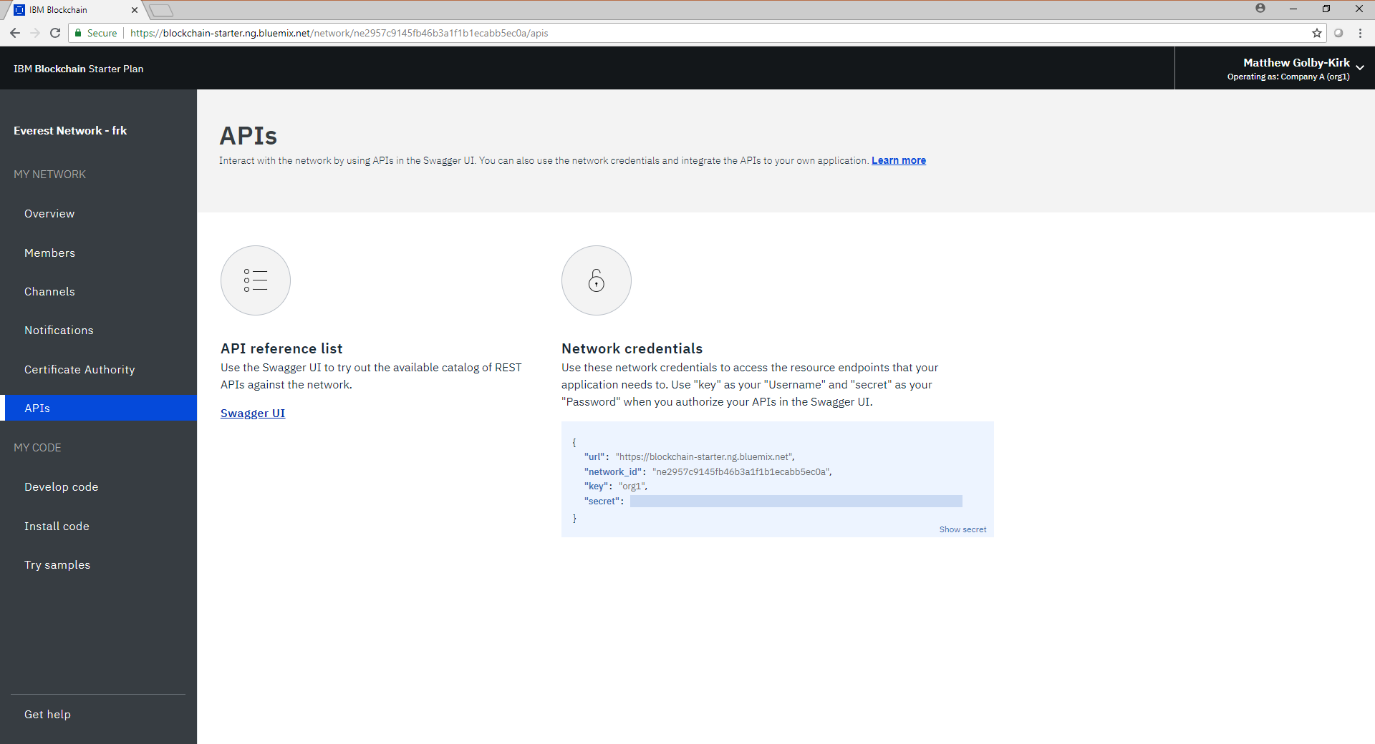

Slide 76
Wrap Up

Slide 77
Further Hyperledger Fabric Information
Project Home: https://www.hyperledger.org/projects/fabric
GitHub Repo: https://github.com/hyperledger/fabric
Latest Docs: https://hyperledger-fabric.readthedocs.io/en/latest/
Community Chat: https://chat.hyperledger.org/channel/fabric
Project Wiki: https://wiki.hyperledger.org/projects/fabric
Design Docs: https://wiki.hyperledger.org/community/fabric-design-docs

Slide 78
Further information
Platform Information
https://www.ibm.com/blockchain/platform/
Platform Documentation
https://console.bluemix.net/docs/services/blockchain/index.html
Platform Service
https://console.bluemix.net/catalog/services/blockchain
Platform Service Level Agreement
http://www-03.ibm.com/software/sla/sladb.nsf/pdf/6605-12/$file/i126-6605-12_11-2017_en_US.pdf
ISO Certification
https://www-935.ibm.com/services/multimedia/saas_27k.pdf
https://www-935.ibm.com/services/us/en/it-services/pdf/ibmcloud_27017.pdf
https://www-935.ibm.com/services/multimedia/ibmcloud_27018.pdf
Blockchain Development Patterns
https://developer.ibm.com/code/technologies/blockchain/

Slide 79
Helpful Links
Deploy a sample application to the IBM Blockchain Platform Starter Plan
https://www.ibm.com/developerworks/cloud/library/cl-deploy-fabcar-sample-application-ibm-blockchain-starter-plan/index.html
Installing pre-reqs and a local dev environment for Composer:
https://console.bluemix.net/docs/services/blockchain/develop.html#develop-the-network
Standalone Dev Example Part 1: Build a blockchain network
https://developer.ibm.com/code/patterns/build-a-blockchain-network
https://github.com/IBM/BlockchainNetwork-CompositeJourney
Standalone Dev Example Part 2: Create and execute blockchain smart contracts
https://developer.ibm.com/code/patterns/create-and-execute-blockchain-smart-contracts
https://github.com/IBM/BlockchainSmartContractTrading-CompositeJourney
Standalone Dev Example Part 3: Automate business processes via blockchain events
https://developer.ibm.com/code/patterns/automate-business-processes-via-blockchain-events
https://github.com/IBM/BlockchainEvents-CompositeJourney

Slide 80
- End of Presentation -
Thank you

